Slide 1


Voyager Team Science
Mrs. Anestad

Slide 2
What do we learn in sixth grade science?
Process skills
Astronomy
Earth History
Weather and Climate

Slide 3
Activities/labs
You probably noticed we’re not in a traditional looking science classroom. That’s okay ☺!
Hands on activities
Working in groups
  Edible item observation lab: observe an edible item and make a hypothesis on what will happen when submerged in a cup of water
  Working with a partner, measure various items using the metric system
No science fair – this is done in 8th grade

Slide 4
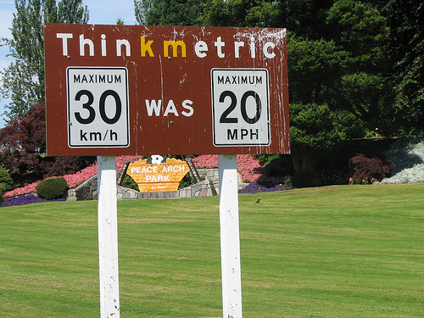
Science Process Skills
Metric System
Scientific Process

Slide 5
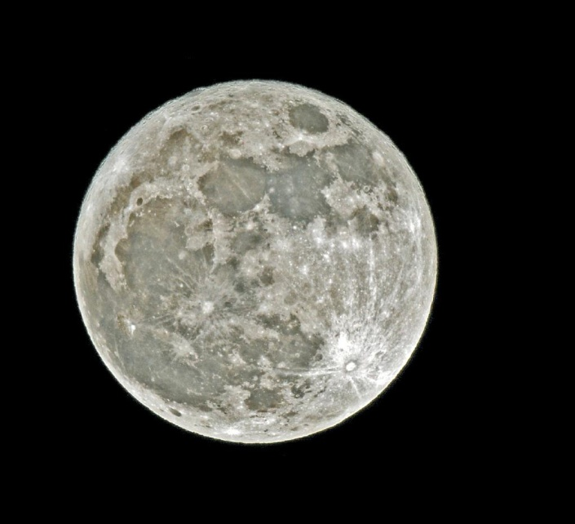
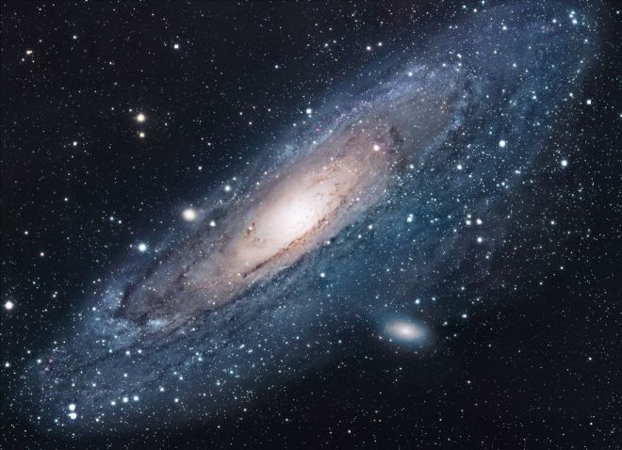
Astronomy
Space Exploration
Sun, Earth, & Moon
Solar System
Planet research and project

Slide 6
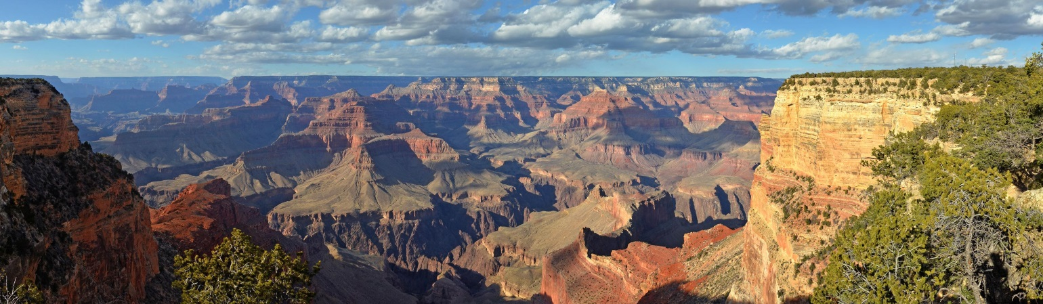
Earth History
Look at the process and systems that helped form the Earth.
Grand Canyon formation
Analysis of rocks and the rock cycle

Slide 7
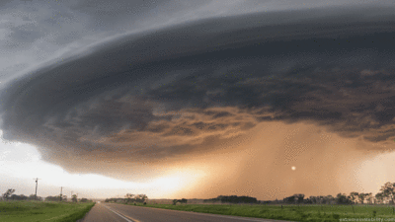
Weather & Climate
investigate local weather and climate data and consider the impact of weather and weather-related disasters
relationship between weather and climate
investigate the factors that cause weather

Slide 8
Grades
Grades are based on a total points system, there is not a breakdown by categories
General rule: The more time we spend on it, the more points it is worth
Projects – some independent and some with partners. If partner work I let the students choose their own partners and work in groups of two or three.
Assessments within each unit
  Always advanced notice and in class review
  Studying at home will also be needed

Slide 9
Homework
As with language arts, having something totally new for homework is rare
However, might need to finish classwork at home
As with language arts, it should not take more than about 15 minutes to complete.
If you find homework is taking a lot of time, please contact me so we can discuss

Slide 10
Supplies
There will be some requests during the year for small supplies. Thank you in advance for your help in sending in these supplies. Items may include things like a food item for the edible item observation, paper towels, or other low cost items.
In general the classroom runs out of tissues by late winter/early spring. If you are ever able to send in extras it is greatly appreciated.

Slide 11
Literacy Explorations – period 10
This has nothing to do with Science but since I have some extra time…
Every other day and might not be with me (and not every student has it, so don’t be alarmed if it’s not on your child’s schedule)
It is an ungraded class, but students are of course still expected to complete the classwork

Slide 12
Periods 3 and 7/8 - specials
One of the periods is phys ed every other day with language and coding every other day. Ex: ACE phys ed; BDF French.
Students take exploratory French, Spanish and computers
The other period is specials. Each one lasts for a vector which is about eight weeks. Sixth grade specials are tech ed, family and consumer science, music, digital literacy and art.
Specials are all graded classes
If you have questions about a grade in specials, reach out to that teacher

Slide 13
Period 10 - Advisory
Music ensembles (Chorus, Band, Orchestra)
Support from Mrs. Rhone (special education)
Small group instruction for enrichment and support – observations from teachers in regards to areas of need.
MTSS – Multi Tiered Systems of Support (students take an online assessment three ties per year which shows areas of needs and instruction in small groups given based on needs)
Might be with me or Mrs. Terry depending on targeted skill – fluid based on need
This is NOT a study hall and students should not expect to be able to use the time for homework.

Slide 14

Thank you for coming and I am sure your child will have a great year on the Voyager team. I’m excited and I hope they are too!

